Slide 1
WeatherWear Implementation of Client-Server API Calls for a Web-Based Application
Joseph Sivits
CSC-3440-0 Computer Networking and Communication
Dr. Selvanayaki Kolandapalayam Shanmugam

Slide 2







Objective
Create a web-based application that can create predictions of what the user should wear based on the weather conditions.

Slide 3

Scope
The project will exist as a native web app, with portability to mobile devices.
Implements networking through client-to-server connection for API calls.
Connects the algorithm to user-controlled preferences and location data using Transmission Control Protocol (TCP).

Slide 4
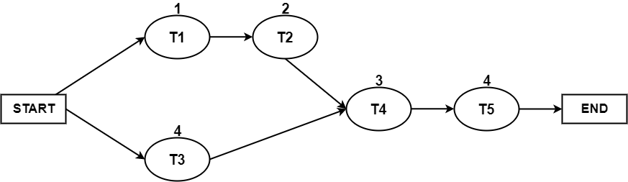
Project Management Plan
Task | Description | Time (days) | Dependencies
T1 | Obtain API Key | 1 | -
T2 | Create Weather Call to API | 2 | T1
T3 | Design Website | 4 | -
T4 | Implement API Call to Website | 3 | T2, T3
T5 | Stylize Site | 4 | T4
Cost per Day | $500
Estimated Development Days | 14
Estimated Days for Testing | 6
Estimated Days for Evolutions | 10
Total Days for Development | 30
Estimated Total Cost | $15,000

Slide 5
Requirements of the Project
The system should be able to call the weather based off of a users ZIP code.
The system should be able to tell the user the future weather conditions, and the current weather conditions.
The system should tell the user what to wear based on the current weather conditions.

Slide 6






Technology Used
HTML5
CSS
JavaScript
jQuery
OpenWeatherMap API
Visual Studio Code
Networking Protocols
Notes:
Uses Hypertext Transfer Protocol and Transmission Control Protocol.

Slide 7

Hardware Requirements for Project
Computer with capabilities of connecting to the internet.

Slide 8

Software Requirements for Project
Integrated Development Environment capable of compiling HTML5, CSS, and JavaScript.
Cloud-based REST* API for real-time and future weather reports

Slide 9
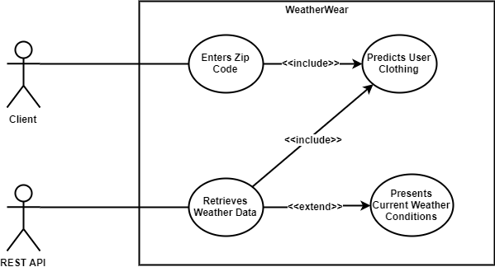
Architecture for Project

Slide 10
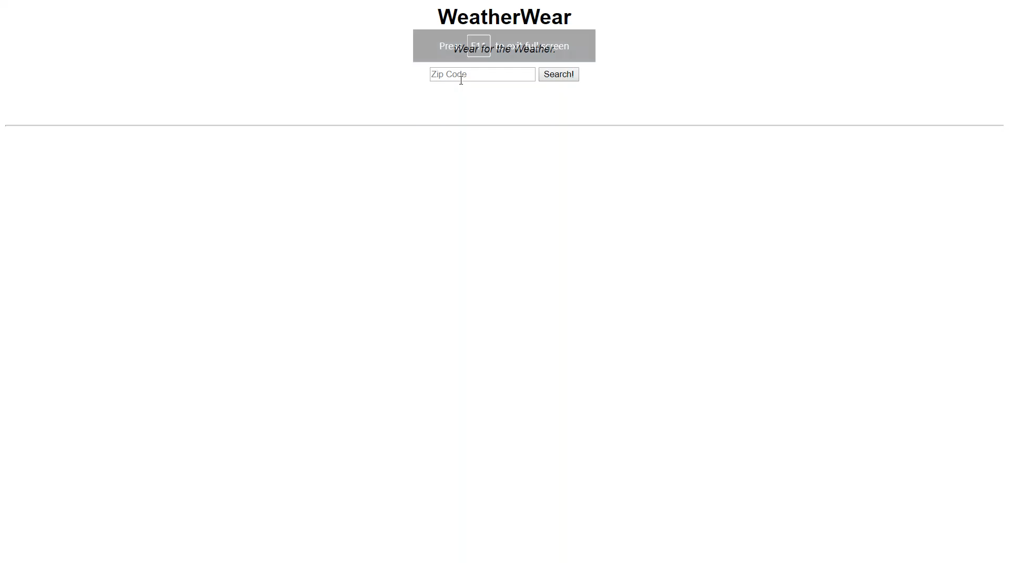
Project Demo

Slide 11

Conclusion
Overall, I’d consider this project a success.
At the beginning I wanted to use GoogleWeatherAPI, I found OpenWeatherAPI to be better as it is a good free alternative with plenty of helpful videos.

Slide 12

Future Enhancements
Profile Implementation
Selection of styles and preferences
When logged in ZIP code is not necessary
Advertisements tailored to location
Local food places could advertise
Brands could advertise for weather conditions
Make application as non-geographic specific

Slide 13
References
https://openweathermap.org/api Web API Used for Weather Data
https://www.draw.io/ Modeling Software Used
P. Rodeghero, C. McMillan and A. Shirey, "API Usage in Descriptions of Source Code Functionality," 2017 IEEE/ACM 1st International Workshop on API Usage and Evolution (WAPI), Buenos Aires, 2017, pp. 3-6.
S. Dhesikan and P. Kathail, "Broadcast and Network Integration using the Network Control (SDN) API," SMPTE 2016 Annual Technical Conference and Exhibition, Los Angeles, CA, 2016, pp. 1-7.
J. Li, L. Han, S. Zhen and L. Yao, "The assessment of automatic weather station operating quality based on fuzzy AHP," 2010 International Conference on Machine Learning and Cybernetics, Qingdao, 2010, pp. 1164-1168.

